Slide 1
PATTERNS
Are schematic solutions for a class of related problems
Serve to represent and reuse software development knowledge
Reuse is achieved by instantiation
Can be used on different levels of abstraction:
  Problem Frames to represent software development problems
  Analysis patterns for object-oriented analysis
  Architectural patterns for software architectures
  Design patterns for object-oriented design
  Idioms for object-oriented programming
Java Design Patterns

Slide 2
REPRESENTATION OF PATTERNS
name, possibly synonyms
problem
  motivation, application domain
solution(s)
  structure (class diagram)
  components (schematic class and object names)
  description, possibly application ow, e.g sequence diagram
discussion
  advantages and disadvantages, dependencies, restrictions
related patterns (similarities)
Java Design Patterns

Slide 3
PATTERNS IN THE ANALYSIS PHASE
Help to set up class models (first model in Fusion OOA)
Serve to improve class structures (refactoring)
Depend on application domain
Are mostly used for business applications
Patterns are a starting point, not a destination.
Martin Fowler
Java Design Patterns

Slide 4
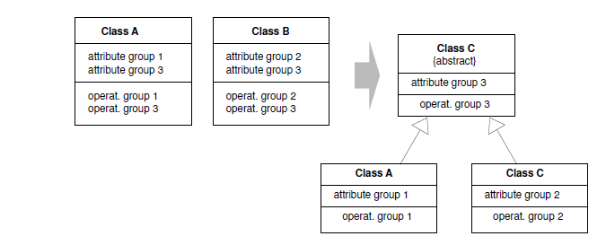
ABSTRACT SUPERCLASS
Universal pattern
Problem: Classes contain groups of identical attributes and operations.
Solution: Separate the identical features in an abstract superclass.
Java Design Patterns

Slide 5
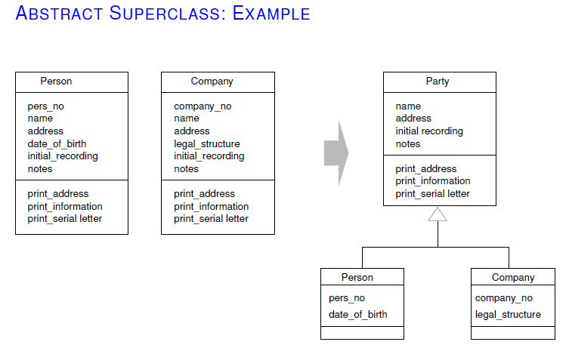
Java Design Patterns

Slide 6
Java Design Patterns
A design pattern is a general reusable solution to a commonly occurring problem in software design. A design pattern is not a finished design that can be transformed directly into code. It is a description or template for how to solve a problem that can be used in many different situations. Object-oriented design patterns typically show relationships and interactions between classes or objects, without specifying the final application classes or objects that are involved.
Java Design Patterns

Slide 7
Design Patterns
Introduction to Design Patterns
  Pattern’s Elements
  Types of Design Patterns
Java Design Patterns
  The Factory Pattern
  The Abstract Factory Pattern
  The Builder Pattern
  The Prototype Pattern
  The Singleton Pattern
  The Adapter Pattern
  The Bridge Pattern
  The Composite Pattern
  Java BluePrints Patterns Catalog
Java Design Patterns

Slide 8
Design Patterns
:: What is a Design Pattern?
Design patterns represent the best practices used by experienced object-oriented software developers. Design patterns are solutions to general problems that software developers faced during software development. These solutions were obtained by trial and error by numerous software developers over quite a substantial period of time.
Design patterns capture the best practices of experienced object-oriented software developers.
Design patterns are solutions to general software development problems.
Java Design Patterns

Slide 9
Design Patterns
:: Pattern’s Elements – Pattern Name
In general, a pattern has four essential elements.
The pattern name
The problem
The solution
The consequences(sonuclar)
Java Design Patterns

Slide 10
Design Patterns
:: Types
Erich Gamma, Richard Helm, Ralph Johnson and John Vlisides in their Design Patterns book define 23 design patterns divided into three types:
  Creational patterns are ones that create objects for you, rather than having you instantiate objects directly. This gives your program more flexibility in deciding which objects need to be created for a given case.
  Structural patterns help you compose groups of objects into larger structures, such as complex user interfaces or accounting data.
  Behavioral patterns help you define the communication between objects in your system and how the flow is controlled in a complex program.
Java Design Patterns

Slide 11
Java Design Patterns
:: Why Use Patterns with Java?
They have been proven. Patterns reflect the experience, knowledge and insights of developers who have successfully used these patterns in their own work.
They are reusable. Patterns provide a ready-made solution that can be adapted to different problems as necessary.
They are expressive. Patterns provide a common vocabulary of solutions that can express large solutions succinctly.
J2EE provides built in patterns.
Java Design Patterns

Slide 12
Java Design Patterns
:: Creational Patterns and Java II
The Factory Pattern provides a simple decision making class that returns one of several possible subclasses of an abstract base class depending on the data that are provided.
The Abstract Factory Pattern provides an interface to create and return one of several families of related objects.
Java Design Patterns

Slide 13
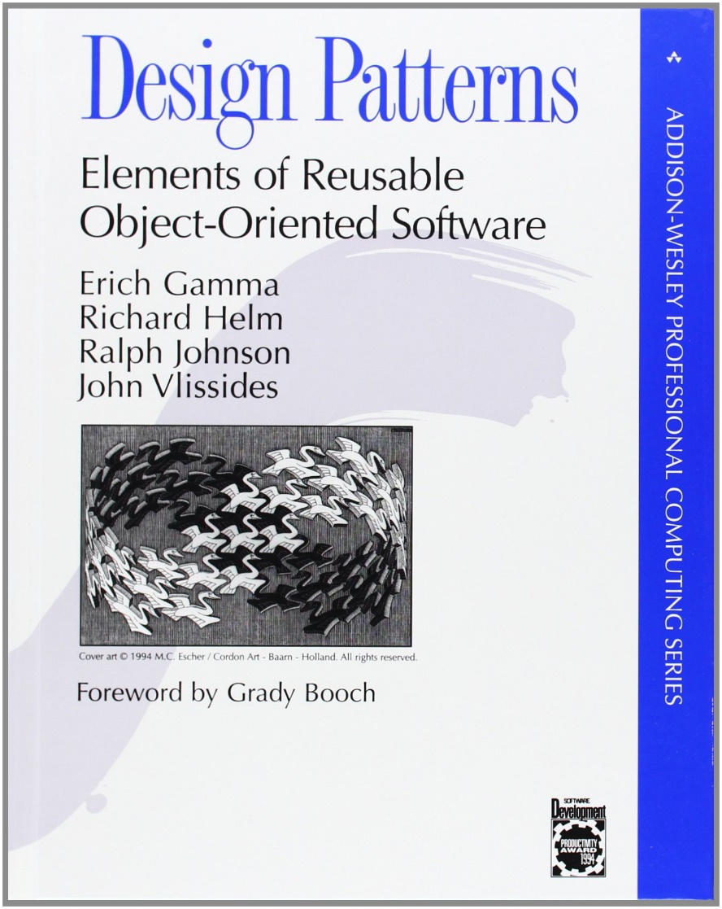
Basically Factory Methods
Define an interface for creatting an object, but you let the subclasses decide which class to instantiate.
Factory methods lets a class defer instantiation to subclasses.
Java Design Patterns

Slide 14
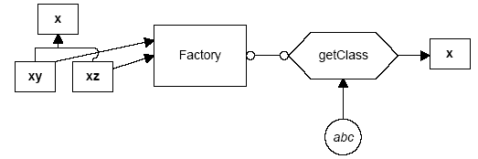
The Factory Pattern
:: How does it Work?
The Factory pattern returns an instance of one of several possible classes depending on the data provided to it.
Here, x is a base class and classes xy and xz are derived from it.
The Factory is a class that decides which of these subclasses to return depending on the arguments you give it.
The getClass() method passes in some value abc, and returns some instance of the class x. Which one it returns doesn't matter to the programmer since they all have the same methods, but different implementations.
Java Design Patterns

Slide 15
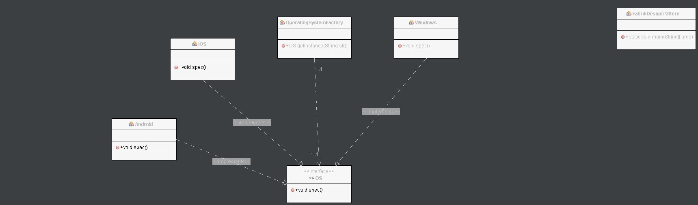
Java Design Patterns

Slide 16
package com;
public interface OS {
public void spec(); }
public class Windows implements OS{
@Override
public void spec() {
System.out.println("Im abt to die..."); }
}
public class Android implements OS {
public void spec(){
System.out.println("Most Powerfull OS"); } }
public class IOS implements OS {
@Override
public void spec() {
System.out.println("Most Secure OS"); } }
public class OperatingSystemFactory {
public OS getInstance(String str){
if (str.equals("Open"))
return new Android();
else if (str.equals("Closed"))
return new IOS();
else
return new Windows(); }}
public class FabrikDesignPattern {
public static void main(String[] args) {
// TODO code application logic here
OperatingSystemFactory osf=new OperatingSystemFactory();
OS obj=osf.getInstance("sdsd");
obj.spec(); }
}
Java Design Patterns

Slide 17
Membership Exapmle
Factory design Pattern
Java Design Patterns

Slide 18
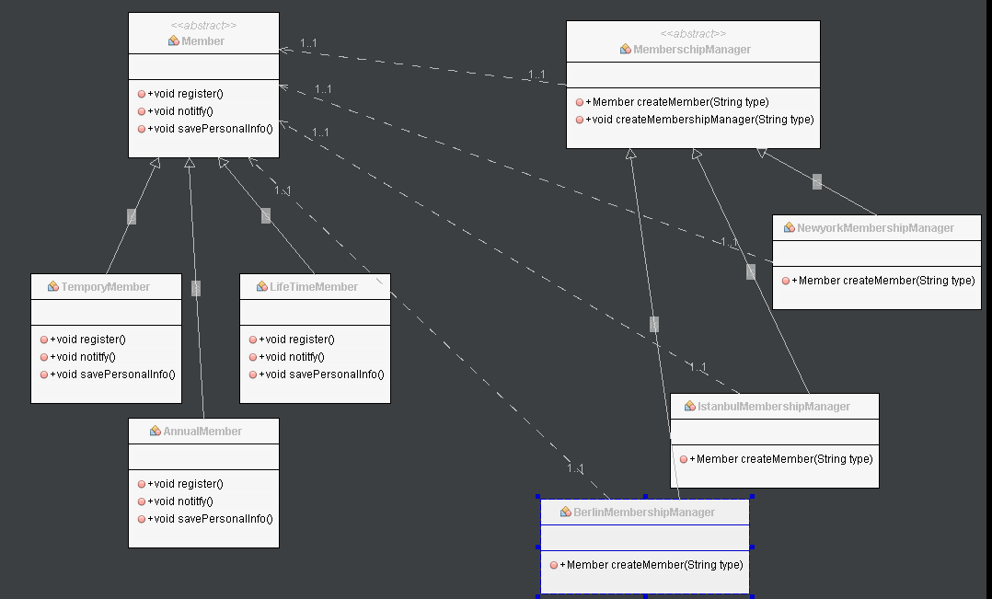


factory
client oft he factory
Java Design Patterns

Slide 19
public abstract class Member {// product
public void register(){};
public void notitfy(){};
public void savePersonalInfo(){};
}
public class TemporyMember extends Member{
@Override
public void register() {
System.out.println("Temporary Type Member registered");
}
@Override
public void notitfy() {
System.out.println("Temporary Type Member");
}
@Override
public void savePersonalInfo() {
}
}
public class AnnualMember extends Member{//concreate produxt
@Override
public void register() {
System.out.println("AnnualMember registered");
}
@Override
public void notitfy() {
System.out.println("AnnualMember");
}
@Override
public void savePersonalInfo() {
}}
Java Design Patterns

Slide 20
public abstract class MemberschipManager {// Standart
public abstract Member createMember(String type);//Factory Method
public void createMembershipManager(String type){
Member m;
m=createMember("AnnualMember");
m.register();
m.notitfy();}
}
public class BerlinMembershipManager extends MemberschipManager {//concrete class
@Override
public Member createMember(String type) {
Member m;
if (type.equals("LifeTime"))
{
m=new LifeTimeMember();
}
else if(type.equals("Tempory Member"))
{
m= new TemporyMember();
}
else {
m= new AnnualMember();
}
return m;
}}
public class IstanbulMembershipManager extends MemberschipManager{
@Override
public Member createMember(String type) {
Member m;
if (type.equals("LifeTime"))
{
m=new LifeTimeMember();
}
else if(type.equals("Tempory Member"))
{
m= new TemporyMember();
}
else {
m= new AnnualMember();
}
return m;
}}
Java Design Patterns

Slide 21
public static void main(String[] args) {
// TODO code application logic here
MemberschipManager mm=new IstanbulMembershipManager();
Member kk= mm.createMember("LifeTime");
// mm.createMembershipManager("LifeTime");
kk.notitfy();
}
}
Java Design Patterns

Slide 22
The Factory Pattern
:: The Base Class
Let's consider a simple case where we could use a Factory class. Suppose we have an entry form and we want to allow the user to enter his name either as “firstname lastname” or as “lastname, firstname”.
Let’s make the assumption that we will always be able to decide the name order by whether there is a comma between the last and first name.
class Namer { //a class to take a string apart into two names
protected String last; //store last name here
protected String first; //store first name here
public String getFirst() {
return first; //return first name
}
public String getLast() {
return last; //return last name
}
}
Java Design Patterns

Slide 23
The Factory Pattern
:: The First Derived Class
In the FirstFirst class, we assume that everything before the last space is part of the first name.
class FirstFirst extends Namer {
public FirstFirst(String s) {
int i = s.lastIndexOf(" "); //find separating space
if (i > 0) {
first = s.substring(0, i).trim(); //left = first name
last =s.substring(i+1).trim(); //right = last name
} else {
first = “” // put all in last name
last = s; // if no space
}
}
}
Java Design Patterns

Slide 24
The Factory Pattern
:: The Second Derived Class
In the LastFirst class, we assume that a comma delimits the last name.
class LastFirst extends Namer { //split last, first
public LastFirst(String s) {
int i = s.indexOf(","); //find comma
if (i > 0) {
last = s.substring(0, i).trim(); //left= last name
first = s.substring(i + 1).trim(); //right= first name
} else {
last = s; // put all in last name
first = ""; // if no comma
}
}
}
Java Design Patterns

Slide 25
The Factory Pattern
:: Building the Factory
The Factory class is relatively simple. We just test for the existence of a comma and then return an instance of one class or the other.
class NameFactory {
//returns an instance of LastFirst or FirstFirst
//depending on whether a comma is found
public Namer getNamer(String entry) {
int i = entry.indexOf(","); //comma determines name order
if (i>0)
return new LastFirst(entry); //return one class
else
return new FirstFirst(entry); //or the other
}
}
Java Design Patterns

Slide 26
The Factory Pattern
:: Using the Factory
NameFactory nfactory = new NameFactory();
String sFirstName, sLastName;
….
private void computeName() {
//send the text to the factory and get a class back
namer = nfactory.getNamer(entryField.getText());
//compute the first and last names using the returned class
sFirstName = namer.getFirst();
sLastName = namer.getLast();
}
Java Design Patterns

Slide 27
The Factory Pattern
:: When to Use a Factory Pattern
You should consider using a Factory pattern when:
A class can’t anticipate which kind of class of objects it must create.
A class uses its subclasses to specify which objects it creates.
You want to localize the knowledge of which class gets created.
There are several similar variations on the factory pattern to recognize:
The base class is abstract and the pattern must return a complete working class.
The base class contains default methods and is only subclassed for cases where the default methods are insufficient.
Parameters are passed to the factory telling it which of several class types to return. In this case the classes may share the same method names but may do something quite different.
Java Design Patterns

Slide 28
The Abstract Factory Pattern
:: How does it Work?
The Abstract Factory pattern is one level of abstraction higher than the factory pattern. This pattern returns one of several related classes, each of which can return several different objects on request. In other words, the Abstract Factory is a factory object that returns one of several factories.
One classic application of the abstract factory is the case where your system needs to support multiple “look-and-feel” user interfaces, such as Windows, Motif or Macintosh:
  You tell the factory that you want your program to look like Windows and it returns a GUI factory which returns Windows-like objects.
  When you request specific objects such as buttons, check boxes and windows, the GUI factory returns Windows instances of these visual interface components.
Java Design Patterns

Slide 29
The Abstract Factory Pattern
:: Consequences of Abstract Factory
One of the main purposes of the Abstract Factory is that it isolates the concrete classes that are generated.
The actual class names of these classes are hidden in the factory and need not be known at the client level at all.
Because of the isolation of classes, you can change or interchange these product class families freely.
Since you generate only one kind of concrete class, this system keeps you for inadvertently using classes from different families of products.
While all of the classes that the Abstract Factory generates have the same base class, there is nothing to prevent some derived classes from having additional methods that differ from the methods of other classes.
Java Design Patterns

Slide 30
Resources
[1] Christopher Alexander, Sara Ishikawa, Murray Silverstein, Max Jacobson, Ingrid Fiksdahl-King, and Shlomo Angel. A Pattern Language. Oxford University Press, New York, 1977.
[2] Erich Gamma, Richard Helm, Ralph Johnson and John Vlissides, Design Patterns – Elements of Reusable Object-Oriented Software, Adisson-Wesley, 1995.
[3] James W. Cooper, The Design Patterns – Java Companion Elements of Reusable Object-Oriented Software, Adisson-Wesley, 1998.
[4] James O. Coplien, Advanced C++ Programming Styles and Idioms, Addison-Wesley, Reading, MA., 1992.
[5] David Geary, Simply Singleton, Java Design Patterns at JavaWorld, April 2003, http://www.javaworld.com/columns/jw-java-design-patterns-index.shtml
[6] Design Patterns, http://www.exciton.cs.rice.edu/JavaResources/DesignPatterns/
[7] Robert Eckstein, Java SE Application Design With MVC, Oracle Technology Network, March 2007. http://www.oracle.com/technetwork/articles/javase/mvc-136693.html
Java Design Patterns

